Slide 1
Music Library Management System
.

Slide 2
1.BACK GROUND
The Music Library Management System aims to provide a user-friendly platform for organizing and managing music collections. It involves creating a database system to efficiently store and manage user accounts, songs, artists, albums, and playlists.

Slide 3
2.DESCRIPTION
The project involves designing and implementing a database system for a music library. This includes creating an Entity-Relationship (ER) diagram, converting it into relational tables, normalizing the tables up to 3rd Normal Form (3-NF), populating the tables with sample data, writing SQL queries to retrieve information, and creating views for customized data perspectives.

Slide 4
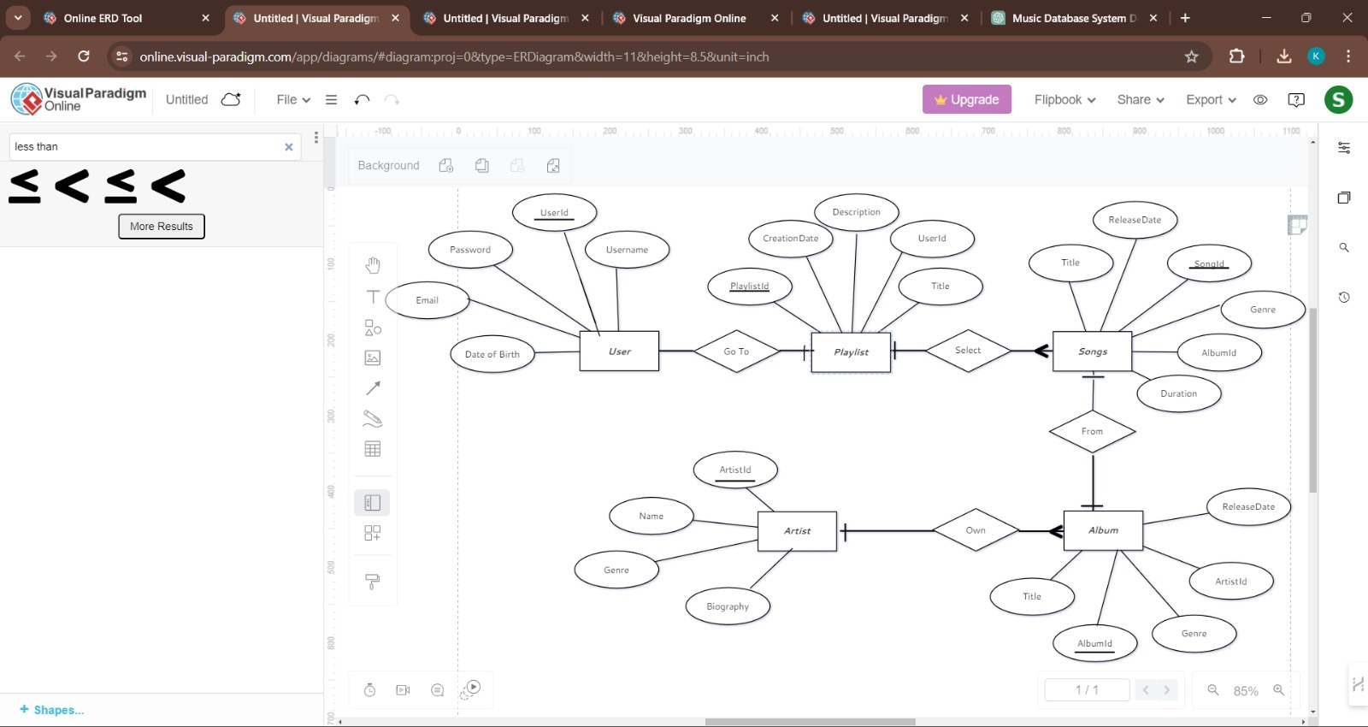
3.ER DIAGRAM

Slide 5
4.DESCRIPTION FOR ER DIAGRAM
❖ Entities and Attributes:
1.USERS: Represents a person who uses the music platform.
Users have attributes User ID,Username,Email,Date of Birth.
2.PLAYLIST:Represents a curated list of songs.
Playlist have attributes Playlist ID,Title,Description,User ID CreationDate.

Slide 6
3.ALBUM:Represents a collection of songs released together by an artist or band.
Album have attributes Album ID,Title,ReleaseDate,Genre,Artist ID.
4.Artist:Represents a musician, band, or performer who creates music.
Artist have attributes Artist ID,Title,ReleaseDate,Genre,Artist ID.
5.SONG:Represents a musical composition typically consisting of lyrics and melody.
Song have attributes Song ID,Title,Duration,ReleaseDate,Genre,
Album ID.

Slide 7
❖ Relationship Between these Entites:-
Song – Album Relationship: One-to-many relationship
Album – Artist Relationship: One-to-many relationship
Playlist – Song Relationship: Many-to-many relationship

Slide 8
5. TABLES FROM ER DIAGRAM
SONG TABLE:
ALBUM TABLE:
Song_ID | INT [PK]
Title | VARCHAR(100)
Duration | INT
ReleaseDate | DATE
Genre | VARCHAR(100)
Album_ID | INT[FK]
Album_ID | INT [PK]
Title | VARCHAR(100)
Artist_ID | INT[FK]
ReleaseDate | DATE
Genre | VARCHAR(100)

Slide 9
ARTIST TABLE:
PLAYLIST TABLE:
USER TABLE:
Artist_ID | INT [PK]
Name | VARCHAR(255)
Biography | TEXT
Genre | VARCHAR(100)
Playlist_ID | INT [PK]
Title | VARCHAR(100)
Description | TEXT
CreationDate | DATE
User_ID | INT [FK]
User_ID | INT [PK]
Username | VARCHAR(100)
Email | VARCHAR(100)
Password | VARCHAR(100)
DateOfBirth | DATE

Slide 10
7. NORMALIZATION OF TABLE UP TO 3-Nf
Normalization is used to minimize the redundancy from a relation or set of relations. It is also used to eliminate undesirable characteristics like Insertion, Update, and Deletion Anomalies.
The normal form is used to reduce redundancy from the database table.
The main reason for normalizing the relations is removing anomalies.
Insertion Anomaly: Insertion Anomaly refers to when one cannot insert a
new tuple into a relationship due to lack of data.
Deletion Anomaly: The delete anomaly refers to the situation where the
deletion of data results in the unintended loss of some other important data.
Updatation Anomaly: The update anomaly is when an update of a single
data value requires multiple rows of data to be updated.

Slide 11
.
First Normal Form (1NF):
Each attribute contains atomic values, and there are no repeating groups.
Second Normal Form (2NF):
All non-key attributes are fully functionally dependent on the primary key.
Third Normal Form (3NF):
No transitive dependencies exist
Atomicity : Each attribute in all tables contains atomic values.
No Partial Dependencies : No partial dependencies exist in any table.
No Transitive Dependencies : no non-key attributes that depend on other non-key attributes.

Slide 12
Few sql queries on the created tables :
Retrieve all songs from a specific album:
Retrieve all playlists created after a specific date:
Retrieve the title and release date of albums released in 2023:
SELECT * FROM Song WHERE Album_ID = 1;
SELECT * FROM Playlist WHERE CreationDate > '2024-01-01';
SELECT Title, ReleaseDate
FROM Album
WHERE YEAR(ReleaseDate) = 2023;

Slide 13
9. CREATION OF VIEWS USING THE TABLES
View 2: Playlist Details
View 1: Songs with Album Titles
View 3: Album Releases by Genre
CREATE VIEW SongWithAlbum AS
SELECT s.Title AS Song_Title, a.Title AS Album_Title FROM Song s
INNER JOIN Album a ON s.Album_ID = a.Album_ID;
CREATE VIEW PlaylistDetails AS
SELECT p.Title AS Playlist_Title, p.CreaƟonDate, u.Username AS User_Username
FROM Playlist p
INNER JOIN Users u ON p.User_ID = u.User_ID;
CREATE VIEW AlbumReleasesByGenre AS
SELECT Genre, COUNT(*) AS Album_Count
FROM Album
GROUP BY Genre;

Slide 14
10.CONCLUSION
A well-designed music library system enhances the way people consume, organize, discover, and share music. It bridges the gap between users and their music collections, offering a more personalized and immersive listening experience.
PROJECT DONE BY
AP22110010007-K.Manaswi
AP22110010029-K.Swathi
AP22110010031-P.Sudhamai
AP22110010039-V. Sri Nidhi
AP22110010042-K.Madhavi

